Slide 1
N8N WORKFLOW AUTOMATION — FINAL CAPSTONE
AI-Powered Customer Support Triage
Turning a fragile demo into a production-ready, sellable system.
Ryan Mwangi • June 2026

Slide 2
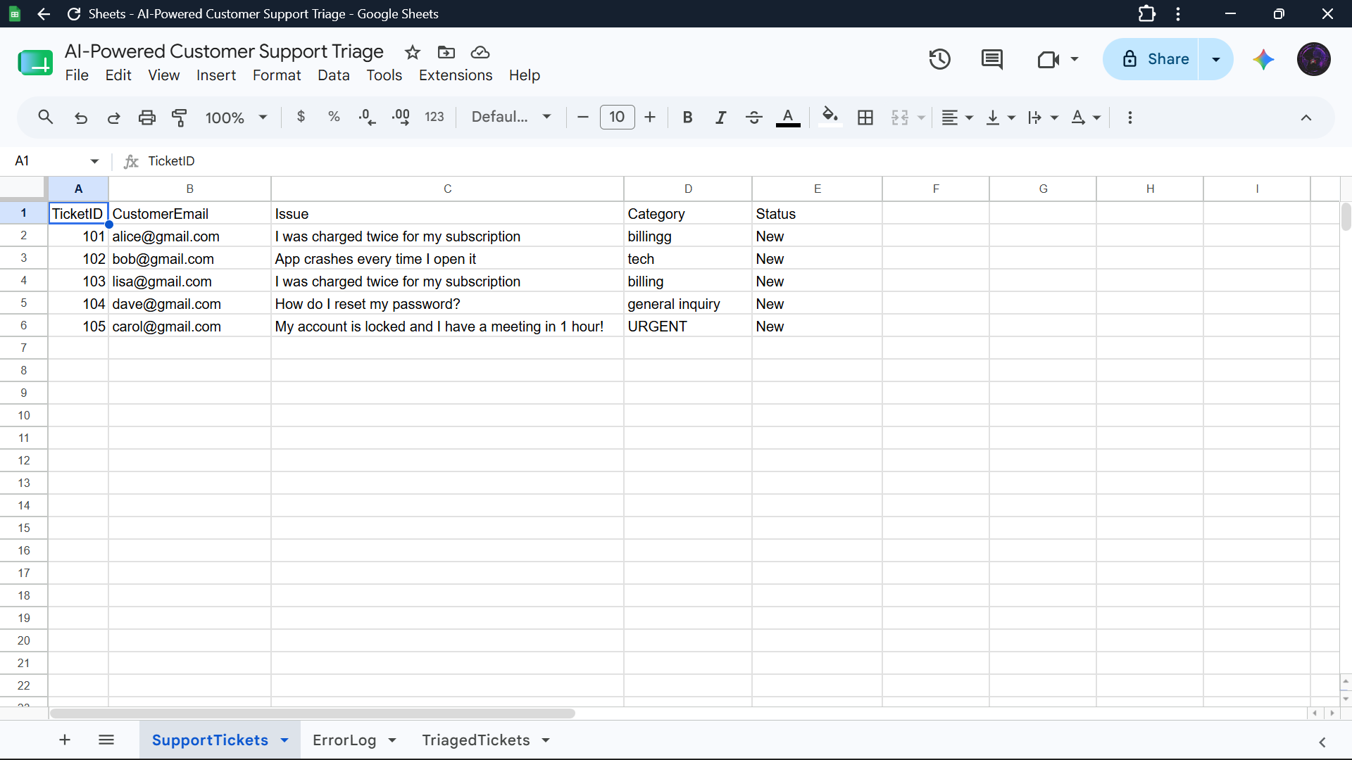
THE PROBLEM
Urgent customers get buried in the noise
Support inboxes mix true emergencies with routine questions.
A double-charged, locked-out customer can sit behind 40 trivial tickets.
Manual triage is slow, inconsistent, and doesn't scale.
Miss the urgent one and you lose the customer.
Raw incoming tickets in the SupportTickets sheet

Slide 3
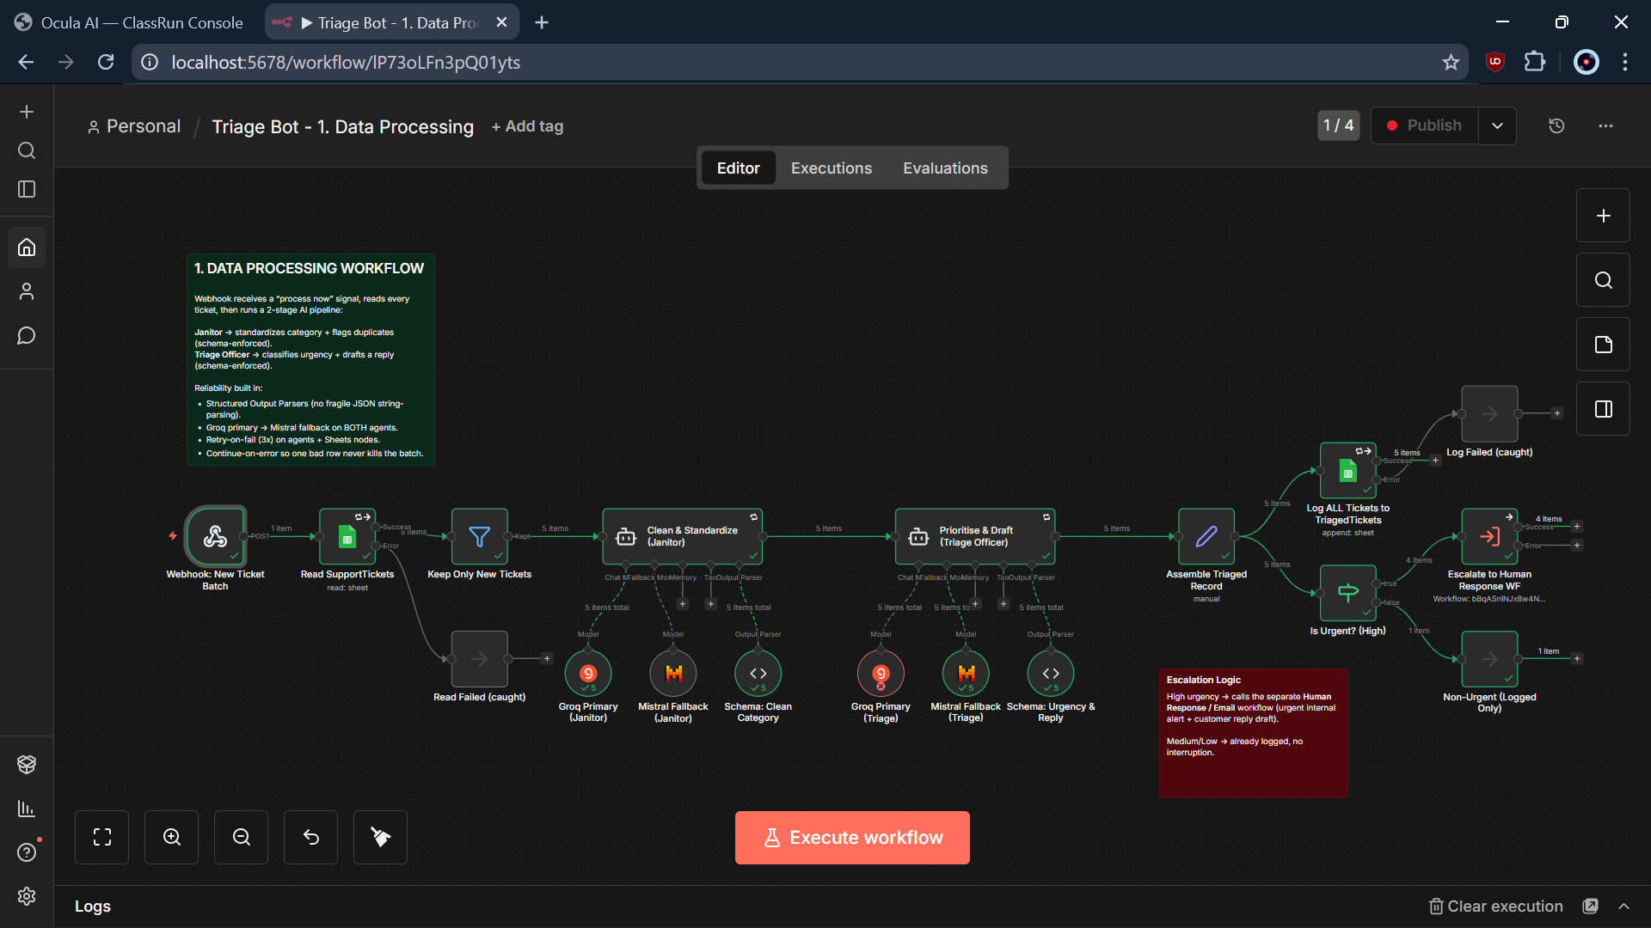
THE SOLUTION
An AI pipeline that triages every ticket automatically
Workflow 1 — the end-to-end data-processing pipeline
Reads every ticket → cleans it → scores urgency → drafts a reply → logs it → escalates the urgent ones.

Slide 4
WHERE I STARTED
The Week-8 design: it looked finished
One straight line of nodes: webhook → read → 2 AI agents → parse → email.
In a clean demo, it worked: AI classified tickets, urgent emails fired.
But it assumed the AI is always perfect, APIs never fail, and nothing breaks mid-run.
In the real world, all three assumptions break.
“It looked finished.”
That was the trap — appearing to work while quietly being fragile.

Slide 5
WHERE COULD IT FAIL?
Five weaknesses — one almost invisible
THE SILENT KILLER: the log step sat on the “urgent” branch only — so every Medium & Low ticket was silently dropped and never recorded. The system looked fine while losing most of its data.
AI output parsed by hand → one stray character crashes the run.
Only one of two agents had a backup model.
No retries, no error handling, no continue-on-error.
No logging or audit trail — a total black box.

Slide 6
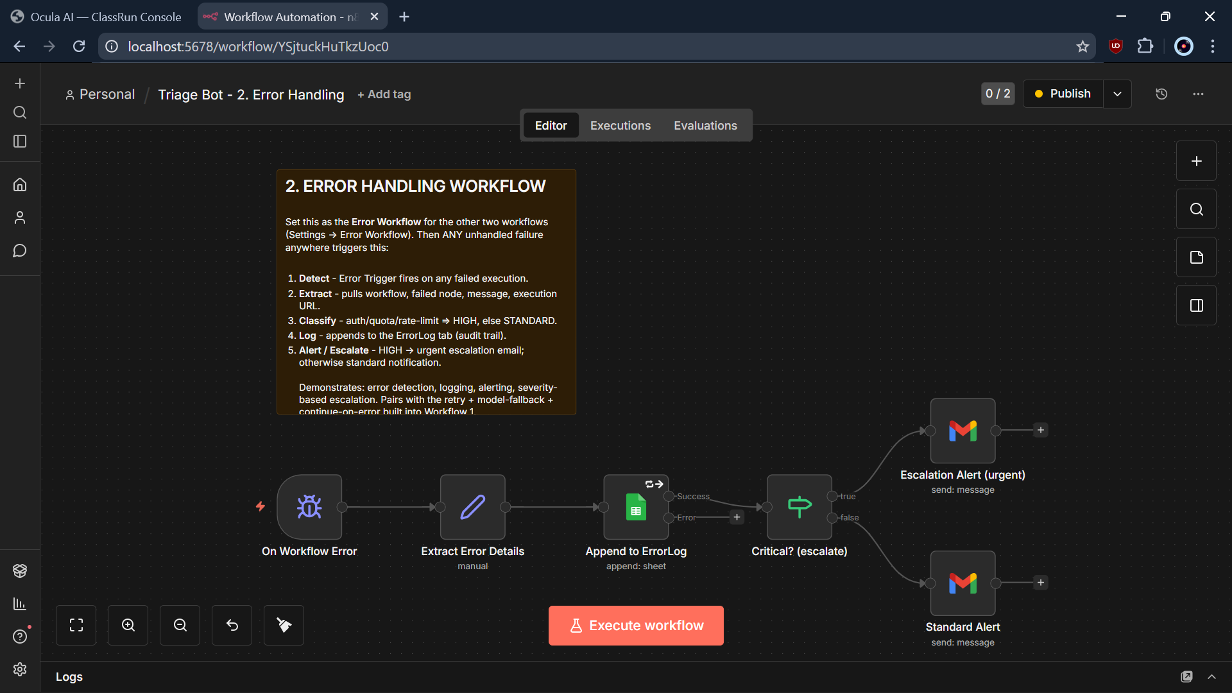
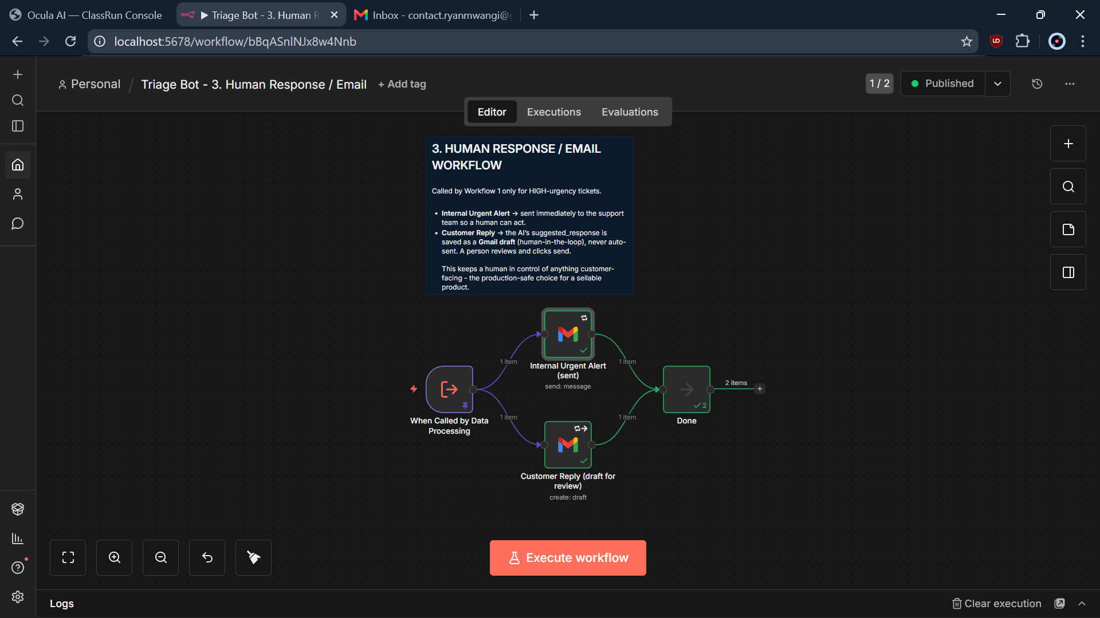
THE ARCHITECTURE
One system, three focused workflows
1
Data Processing
2
Error Handling
3
Human Response
Reads tickets, runs the AI, logs everything, decides urgency.
Catches any failure, logs it, classifies severity, alerts.
Sends the urgent alert and drafts the customer reply.

Slide 7
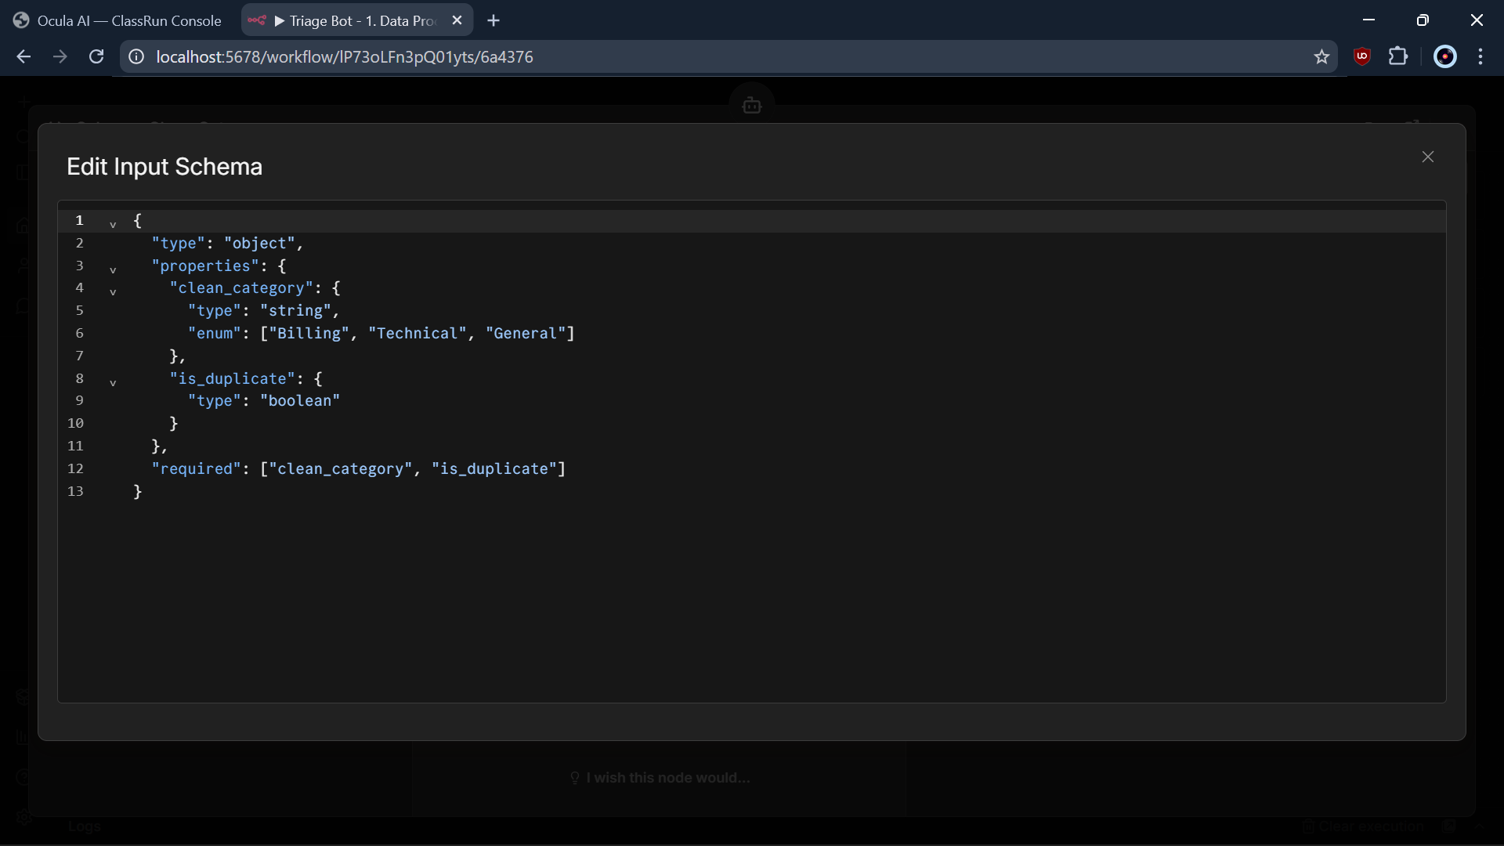
UPGRADE 1 OF 5
Structured AI output — predictable every time
Each agent has a Structured Output Parser bound to a strict JSON schema.
Category can only be Billing, Technical, or General.
Urgency can only be High, Medium, or Low.
Why it's better: a stray word can never crash the pipeline again — output is guaranteed machine-readable.
An enum-locked JSON schema constrains the AI output

Slide 8
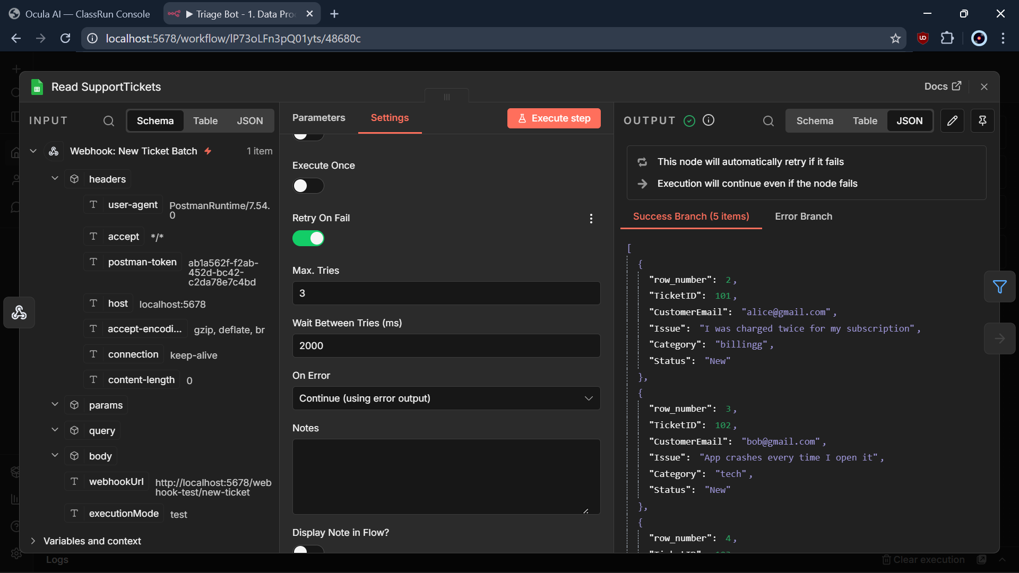
UPGRADE 2 OF 5
Fault tolerance — survive the blips
Agents and Sheets nodes retry automatically — 3 times, with backoff.
Continue-on-error sets a bad ticket aside instead of aborting the batch.
A caught row lands safely; the rest keep processing.
Why it's better: one bad row or one flaky moment can no longer take down the whole run.
Retry-on-fail + Continue-on-error on every key node

Slide 9
UPGRADE 3 OF 5
Model fallback — survive a provider outage
PRIMARY Groq llama-3.3-70b
AI Agent
FALLBACK Mistral large
Groq (Llama 3.3) is primary; Mistral Large is automatic fallback.
If Groq is down or rate-limited, the agent silently switches to Mistral.
Two separate providers fail independently → no single point of failure.
Seen live: when I hit Groq's rate limit, Mistral picked up the work.

Slide 10
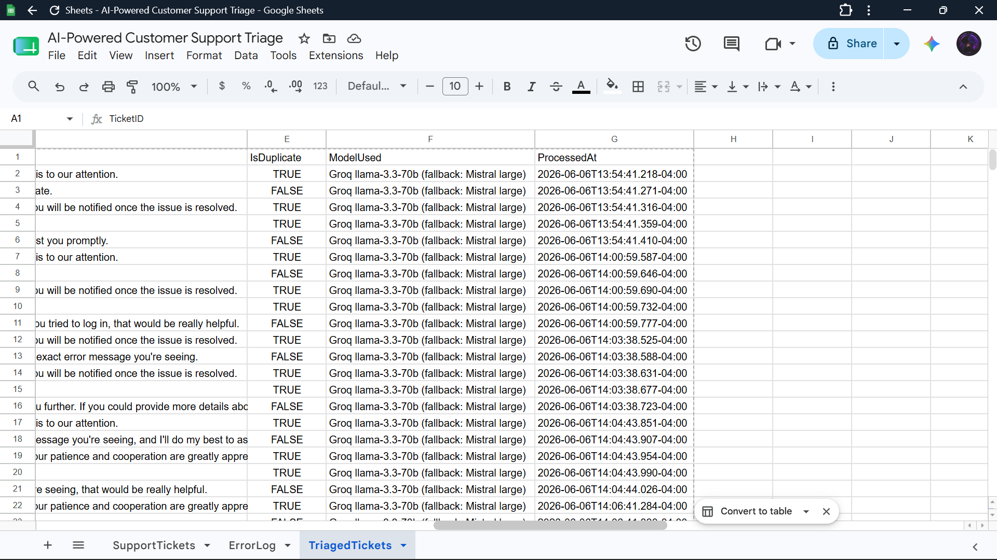
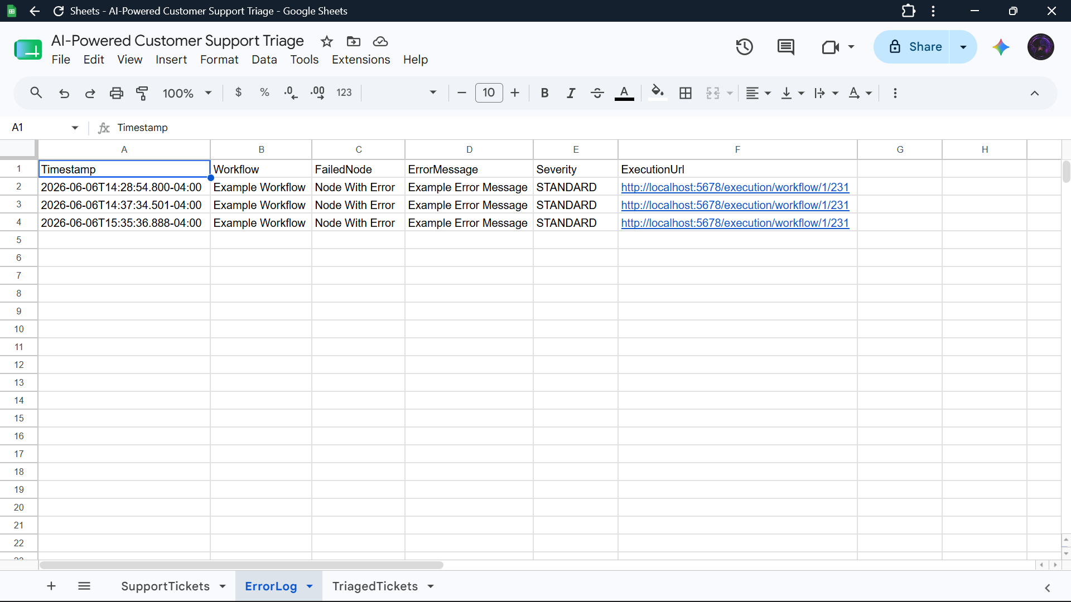
UPGRADE 4 OF 5
Logging & governance — nothing fails silently
Every ticket logged: model used + timestamp
Every error captured in the ErrorLog
Logging moved BEFORE the urgency branch → every ticket is now recorded (the bug fix).
A dedicated error workflow logs every failure with full context + a link to the failed run, and emails the team.

Slide 11
UPGRADE 5 OF 5
Clean architecture + a human in the loop
Split into three independent, testable, reusable workflows.
The customer reply is never auto-sent.
The AI's draft is saved to Gmail for a human to review and approve.
Why it's better: a person stays in control of anything a customer actually sees — the safe, professional choice.
Workflow 3 — Human Response / Email

Slide 12
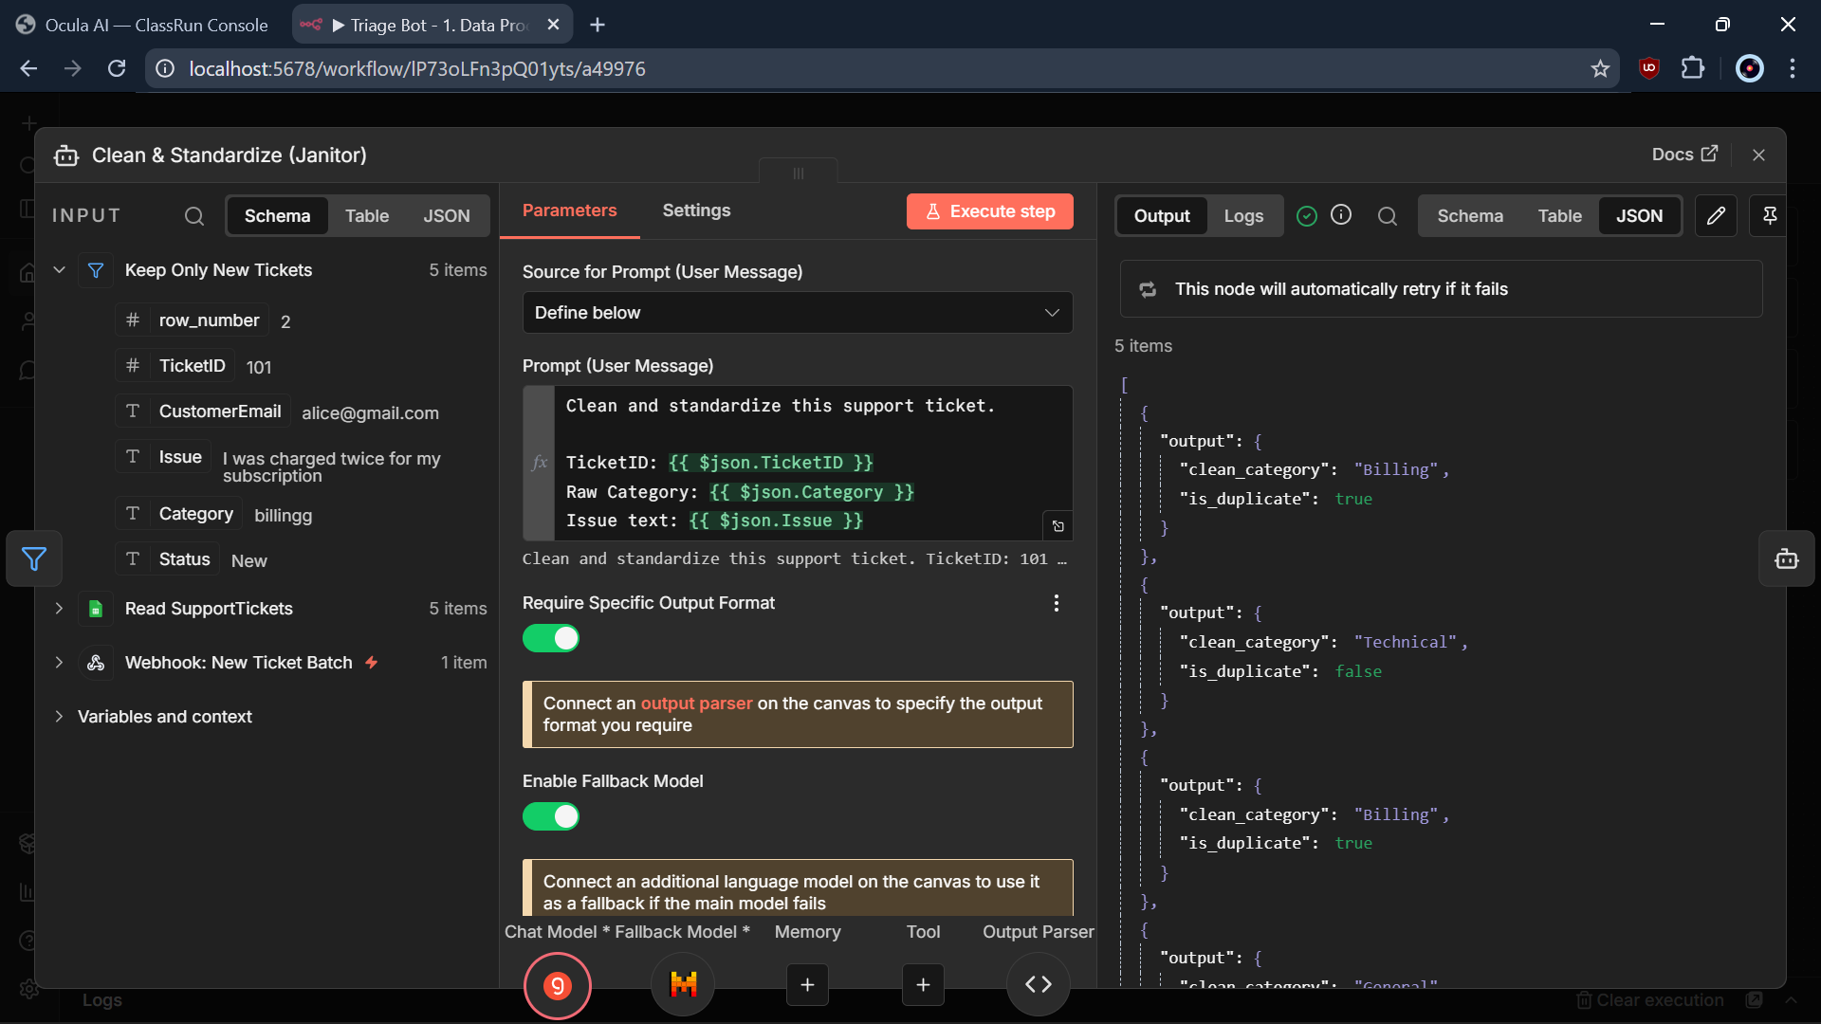
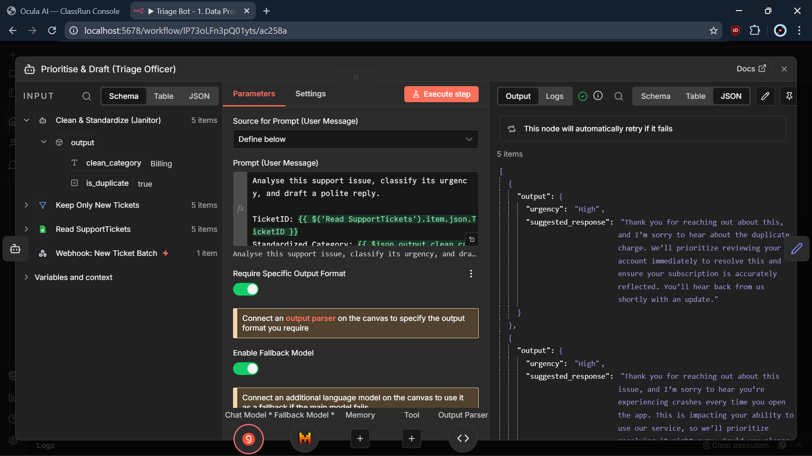
INSIDE WORKFLOW 1
Two AI agents do the thinking
The Janitor — cleans category, flags duplicates
The Triage Officer — scores urgency, drafts a reply
Both are schema-enforced and both run Groq → Mistral fallback.

Slide 13
WORKFLOW 2
Error Handling — the safety net
Fires automatically on any unhandled failure in WF1 or WF3.
Captures workflow, failed node, message + execution link.
Auth / quota / rate-limit → HIGH (escalate); else STANDARD.
Writes to ErrorLog and emails the team.
Detect → Extract → Log → Classify → Alert

Slide 14
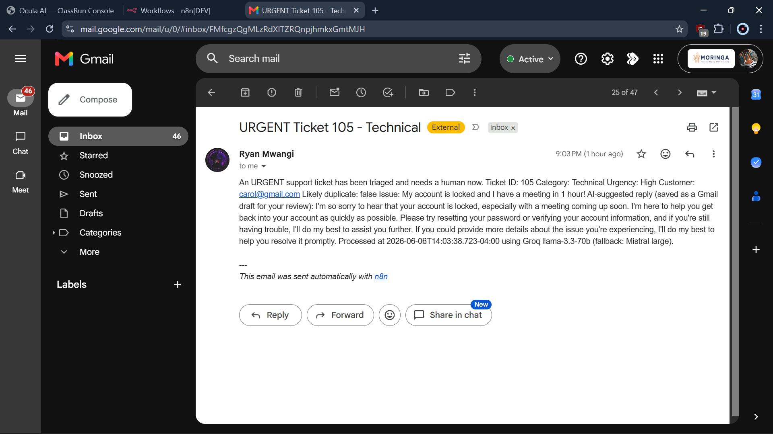
WORKFLOW 3
Human Response — alert + draft
Called by Workflow 1 only for High-urgency tickets.
Internal urgent alert → sent immediately so a human can act.
Customer reply → saved as a Gmail draft for review.
Speed for the team; final say stays with a person.
A real urgent-alert email to the team

Slide 15
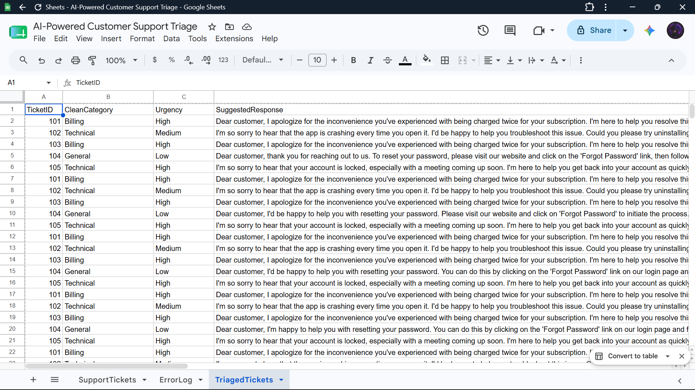
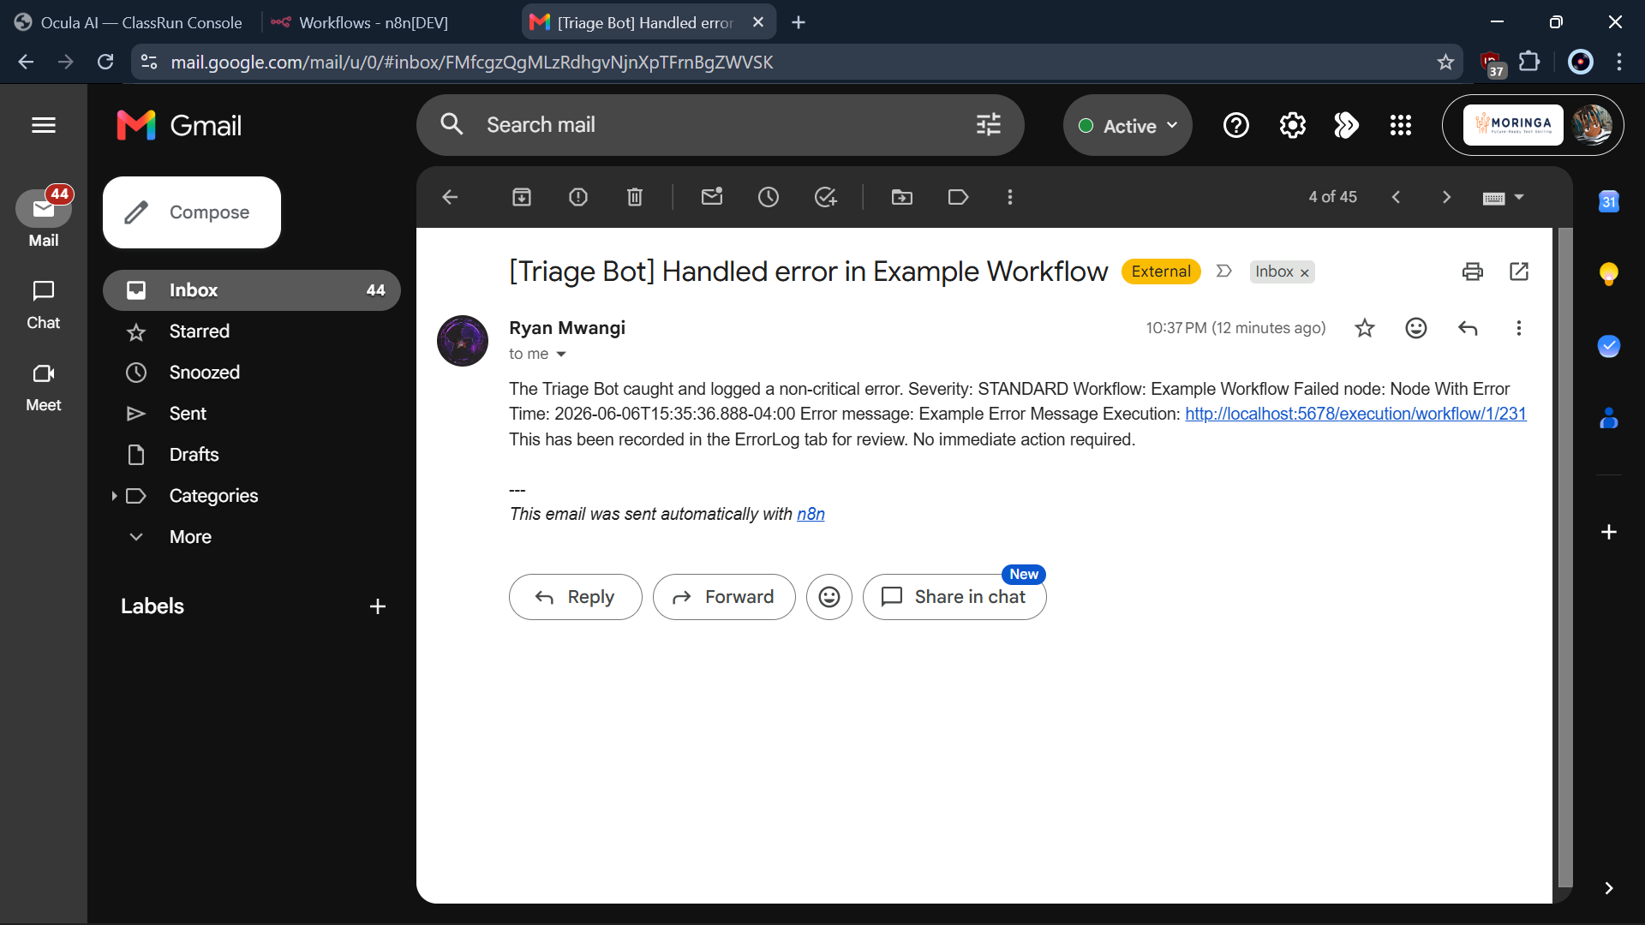
IT WORKS
Execution evidence
TriagedTickets — every ticket logged
Automated error-alert email
Verified end-to-end on n8n 2.8.4: all tickets logged, urgent ones escalated, errors caught and reported.

Slide 16
WHY IT'S MORE ROBUST
From a demo to a production system
BEFORE
AFTER
Silently dropped most tickets
Crashed on odd AI output
Died on the first API blip
A black box — no logs
Logs every ticket (full audit trail)
Schema-enforced, predictable output
Retries + cross-provider fallback
Observable + human-approved replies

Slide 17
OUTCOMES
Business value
Faster response
Nothing lost
Urgent issues reach a human in seconds, not hours.
Every ticket is logged and auditable.
Always on
Sellable
Runs 24/7 with automatic failover.
Clean, documented, deployable — production grade.

Slide 18
“The original looked like it worked — but it quietly lost data and would die at the first hiccup.”
The new version is observable, resilient, predictable, and safe.
Thank you — questions welcome.

